Slide 1

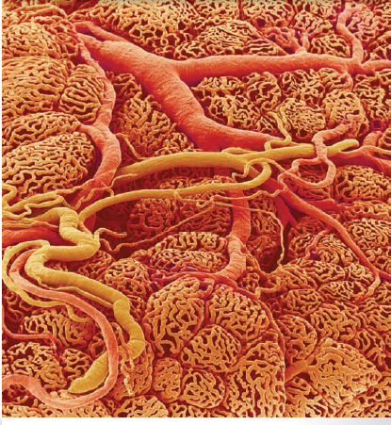

The Endocrine system
Overview of Endocrine system
Al-Farabi Kazakh National University
Higher School of Medicine

Slide 2
LEARNING OUTCOMES
As a result of the lesson you will be able to:
define hormone and endocrine system;
name several organs of the endocrine system;
contrast endocrine with exocrine glands;
recognize the standard abbreviations for many hormones;
and
describe similarities and differences between the nervous and endocrine systems.
describe the anatomical relationships between the hypothalamus and pituitary gland;
distinguish between the anterior and posterior lobes of the pituitary;
list the hormones produced by the hypothalamus and each lobe of the pituitary, and identify the functions of each hormone;
explain how the pituitary is controlled by the hypothalamus and its target organs;
and
describe the effects of growth hormone.
Al-Farabi Kazakh National University
Higher School of Medicine

Slide 3
The glands, tissues, and cells that secrete hormones constitute the endocrine system;
The study of this system and the diagnosis and treatment of its disorders is called endocrinology.
The most familiar hormone sources are the endocrine glands, such as the pituitary, thyroid, and adrenal glands, among others.
The hormones are also secreted by numerous organs and tissues, such as the brain, heart, small intestine,bones, and adipose tissue.

Slide 4
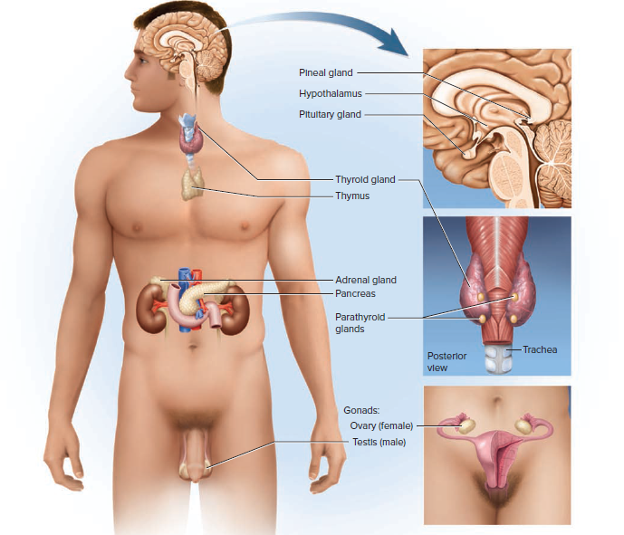

Slide 5
Principal avenues of communication from cell to cell:
Gap junctions join single-unit smooth muscle, cardiac muscle, epithelial, and other cells to each other. They enable cells to pass nutrients, electrolytes, and signaling molecules directly from the cytoplasm of one cell to the cytoplasm of the next through pores in their plasma membranes.
Neurotransmitters are released by neurons, diffuse across a narrow synaptic cleft, and bind to receptors on the surface of the next cell.
Paracrines are secreted by one cell, diffuse to nearby cells in the same tissue, and stimulate their physiology. Some call them local hormones.
Hormones in the strict sense, are chemical messengers that are transported by the bloodstream and stimulate physiological responses in cells of another tissue or organ, often a considerable distance away. Certain hormones produced by the pituitary gland in the head, for example, act on organs as far away as the pelvic cavity

Slide 6
Comparison of Endocrine and
Exocrine Glands
Exocrine glands secrete their products by way of a duct onto an epithelial surface such as the skin or the mucosa of the digestive tract.
Endocrine glands, are ductless and release their secretions into the bloodstream.
Exocrine secretions have extracellular effects such as the digestion of food, whereas endocrine secretions have intracellular effects—they alter cell metabolism.
Endocrine glands have an unusually high density of blood capillaries; (fenestrated capillaries)

Slide 7
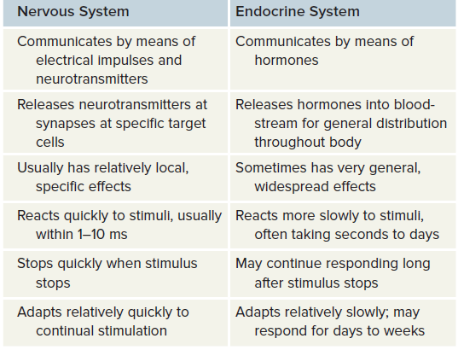
Comparison of the Nervous and Endocrine Systems

Slide 8
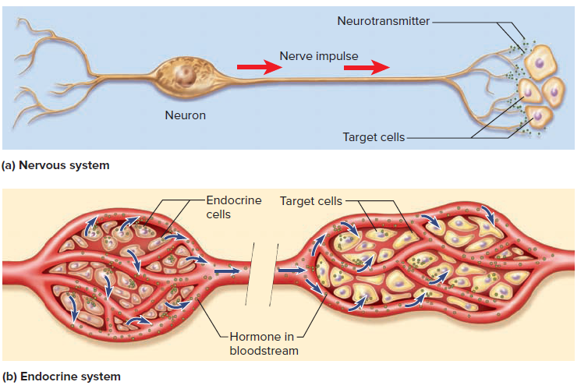

Slide 9
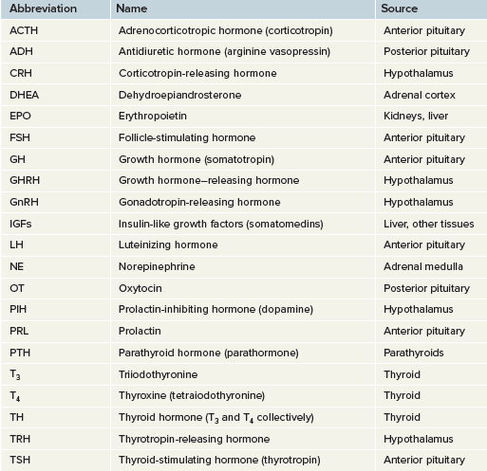
Hormone Nomenclature

Slide 10
The Hypothalamus and Pituitary Gland
The hypothalamus, shaped like a flattened funnel, forms the floor and walls of the third ventricle of the brain;
It regulates water balance and thermoregulation to sex drive and childbirth.
The pituitary is about 1.3 cm;
It is actually composed of two structures—the anterior and posterior pituitary
The anterior pituitary, or adenohypophysis. It has no nervous connection to the hypothalamus but is linked to it by a complex of blood vessels called the hypophyseal portal system
The posterior pituitary, or neurohypophysis, it is actually nervous tissue not a true gland. Hormones of the posterior pituitary are made by certain neuroendocrine cells in the hypothalamus. Their axons pass down the stalk as a bundle called the hypothalamo–hypophyseal tract and end in the posterior lobe

Slide 11
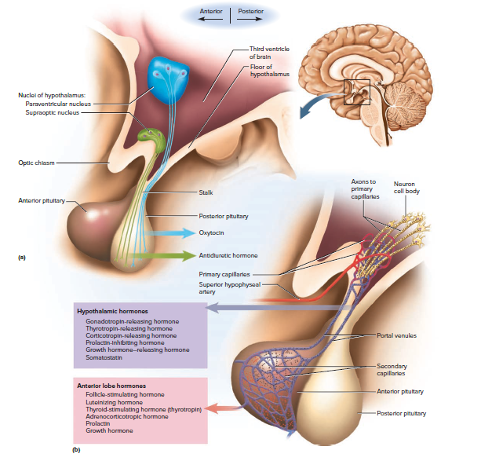

Slide 12
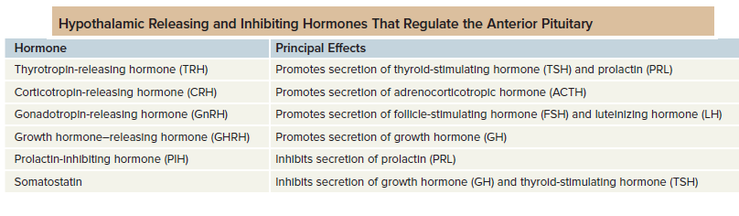
Hypothalamic Hormones
There are eight of these—six to regulate the anterior pituitary and two that are stored in the posterior pituitary and released on demand.

Slide 13
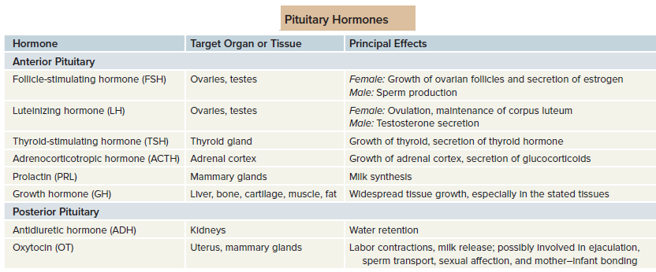
Pituitary Hormones

Slide 14
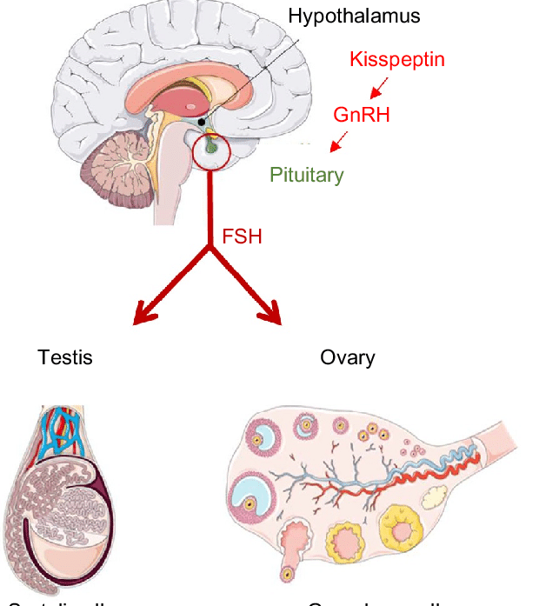
Follicle-stimulating hormone (FSH)is secreted by pituitary cells called gonadotropes.
In the ovaries, it stimulates the secretion of ovarian sex hormones and the development of the bubblelike follicles that contain the eggs.
In the testes, it stimulates sperm production.
Luteinizing hormone (LH) is secreted by the gonadotropes.
In females, it stimulates ovulation, the release of an egg.
LH stimulates the corpus luteum to secrete
progesterone.
In males, LH stimulates the testes to secrete testosterone

Slide 15
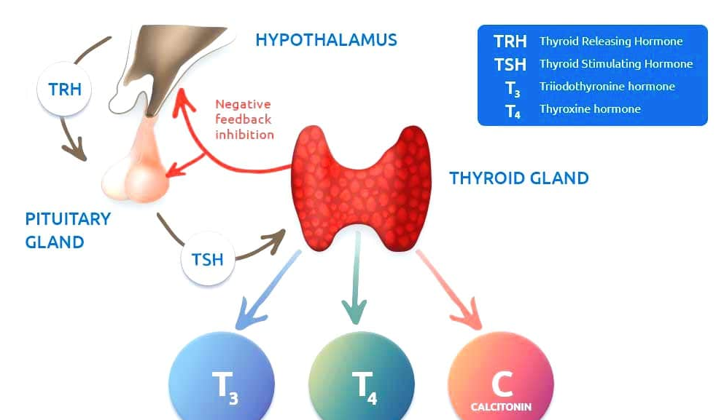
Thyroid-stimulating hormone (TSH), or thyrotropin.
TSH is secreted by pituitary cells called thyrotropes.
It stimulates growth of the thyroid gland and the secretion of thyroid hormone (T3, T4,C)

Slide 16
Adrenocorticotropic hormone (ACTH), or corticotropin.
ACTH is secreted by cells called corticotropes.
Its target organ is the adrenal cortex.
ACTH stimulates the cortex to secrete hormones called glucocorticoids (especially cortisol), which regulate glucose, protein, and fat metabolism and are important
in the body’s response to stress.

Slide 17
Prolactin (PRL) is secreted by pituitary cells called lactotropes (mammotropes).
During pregnancy, the lactotropes increase greatly in size and number, and PRL secretion rises proportionately, but it has no effect on the mammary glands until after a woman gives birth. Then, it stimulates them to synthesize milk.

Slide 18
Growth hormone (GH), or somatotropin.
GH is secreted by somatotropes.
The general effect of GH is to stimulate mitosis and cellular differentiation and thus to promote tissue growth throughout the body.

Slide 19
Antidiuretic hormone (ADH).
ADH increases water retention by the kidneys, reduces urine volume, and helps prevent dehydration.
ADH also functions as a brain neurotransmitter and is usually called arginine vasopressin (AVP).
Oxytocin (OT) has a variety of reproductive functions

Slide 20
Pituitary Hormones

Slide 21
Control of Pituitary Secretion
Pituitary hormones are not secreted at constant rates.
GH is secreted mainly at night,
LH peaks at the middle of the menstrual cycle,
OT surges during labor and breast-feeding.
The timing and amount of pituitary secretion are regulated by the hypothalamus, other brain centers, and feedback from the target organs.

Slide 22
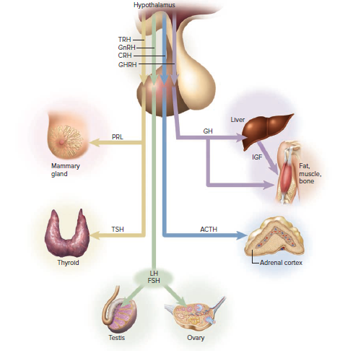
Hypothalamo–Pituitary–Target Organ Relationships

Slide 23
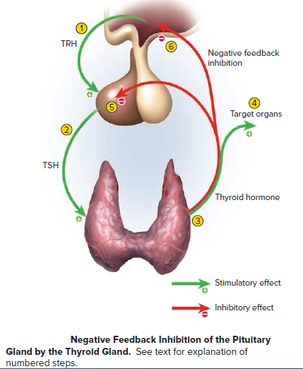
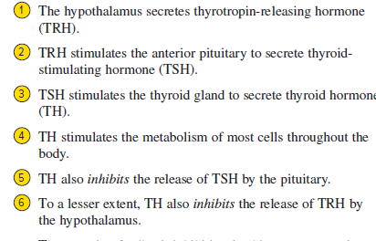
Feedback from Target Organs

Slide 24
If the thyroid gland was removed from a cancer patient, would you expect the level of TSH to rise or fall?
Why?

Slide 25
Growth Hormone
GH has widespread effects on the body.
It directly stimulates diverse tissues such as muscle and bone and
induces the liver and other tissues to secrete growth stimulants called insulin-like growth factors (IGF-I and IGF-II), or somatomedins

Slide 26
The mechanisms of GH–IGF action include the following:
Protein synthesis.
Lipid metabolism.
Carbohydrate metabolism.
Electrolyte balance

